Slide 1

HOSPITAL MANAGEMENT final presentation
By:
Lola Sánchez,
María Rueda,
Jaime Soler,
Kacper Borysewicz

Slide 2
INTRODUCTION & QUICK REMINDER
Control the logistic functions of a hospital
Create relationships between a patient and a doctor, a doctor and a nurse and a nurse with the patient.
Improve the doctor´s and nurse´s job and the access to all the information.
Follow a diagnosis and provide them with medicines
Involved with the patient during all his stay
Doctors, nurses and patients can register

Slide 3





INTRODUCTION & QUICK REMINDER
7 use cases
8 functional requirements
3 non-functional requirements

Slide 4
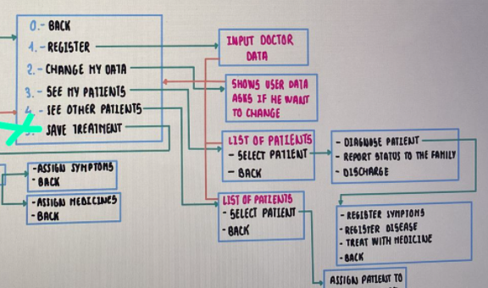

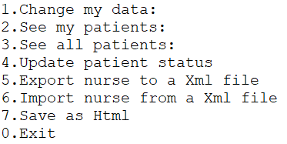
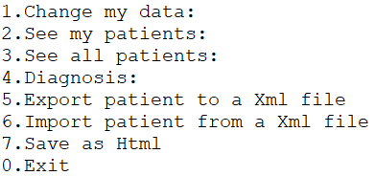
BIG CHANGES

Slide 5

UML

Slide 6
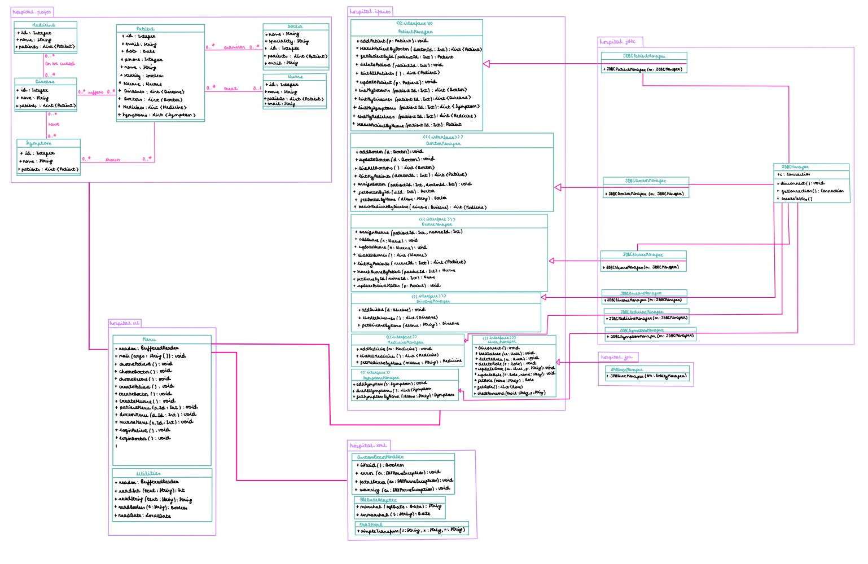

Slide 7
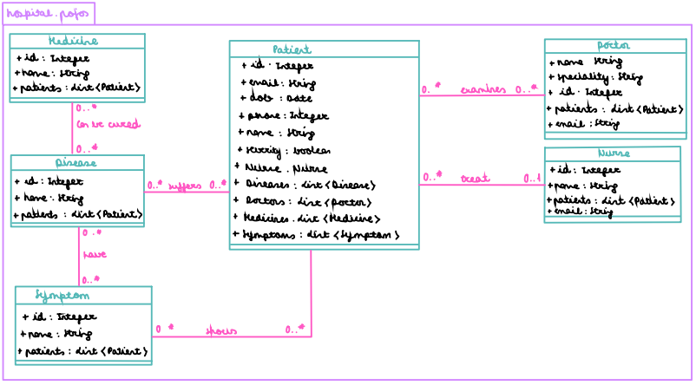
UML

Slide 8
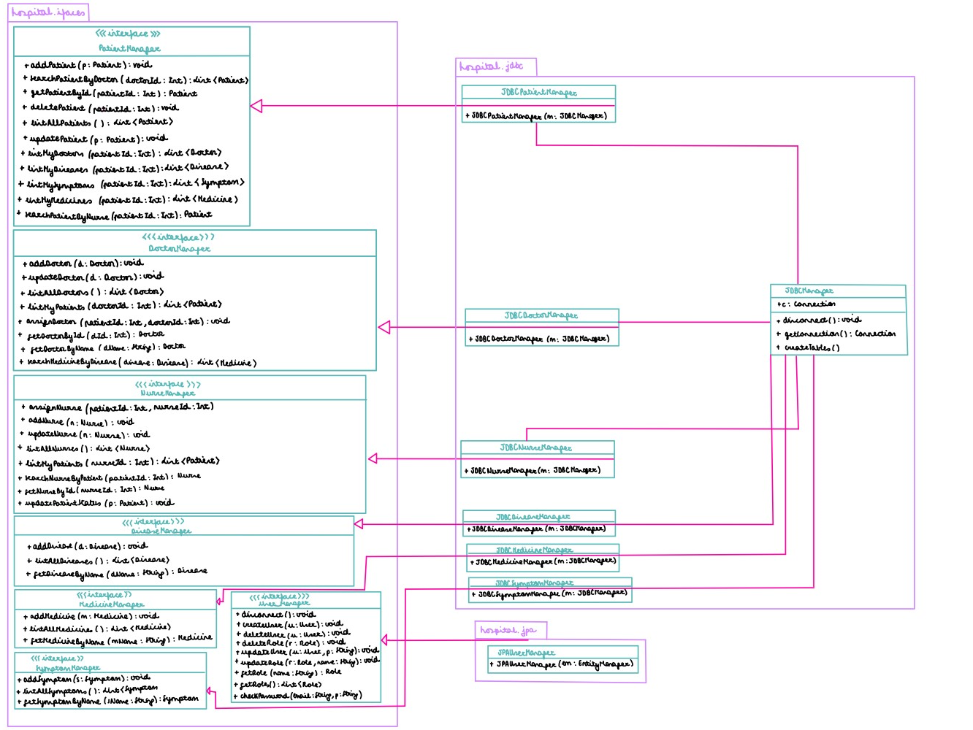

Slide 9
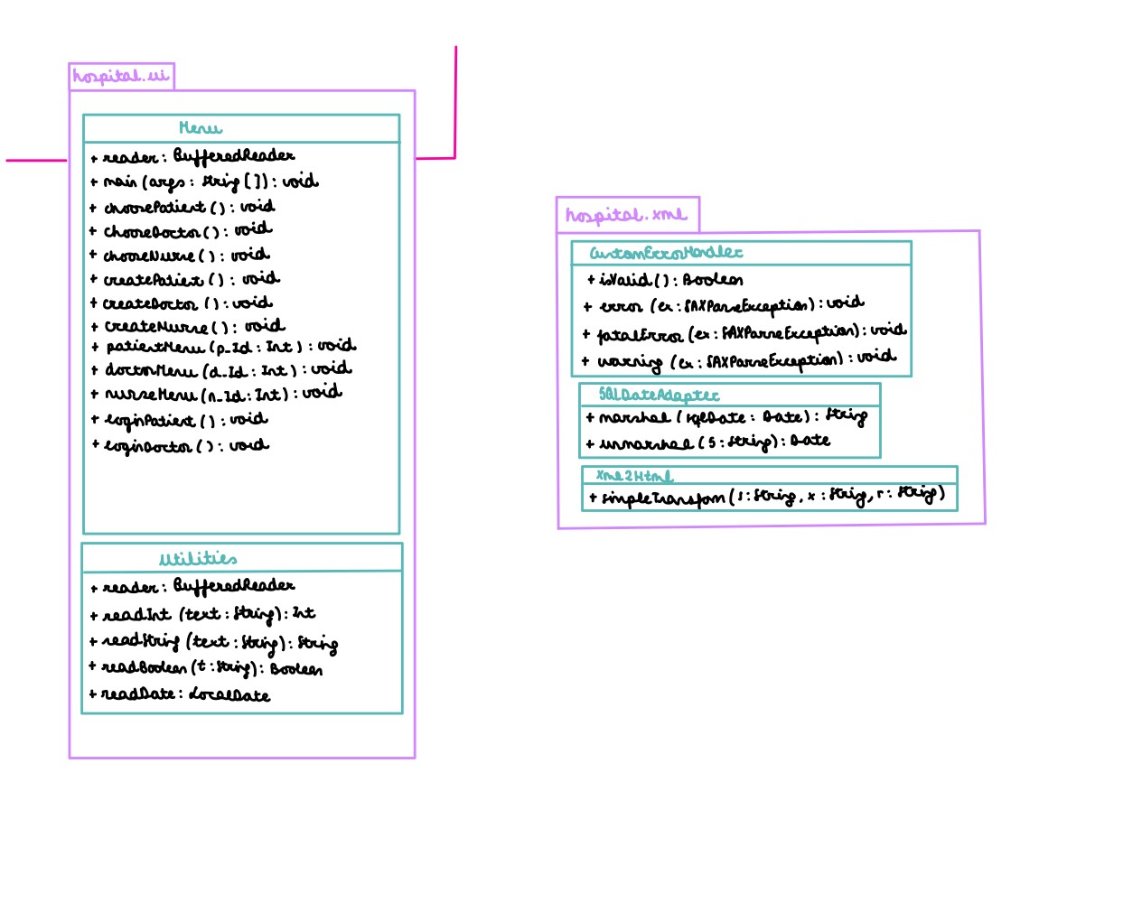

Slide 10
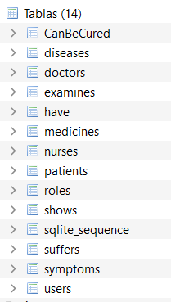
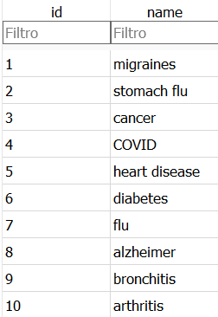
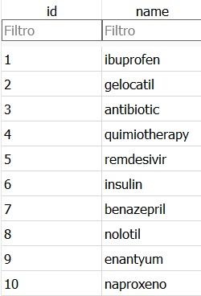
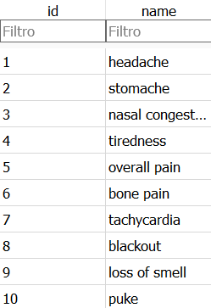
JDBC MANAGER
Diseases inserted
Our tables
Medicines inserted
Symptoms inserted

Slide 11
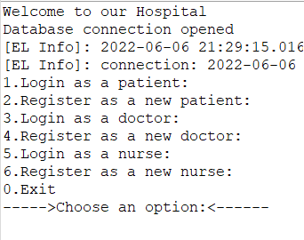
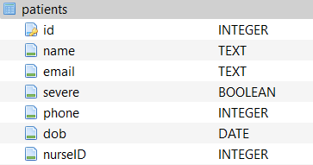
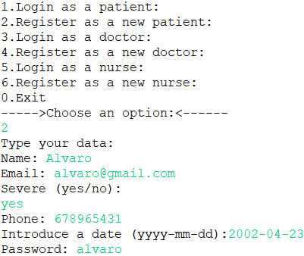
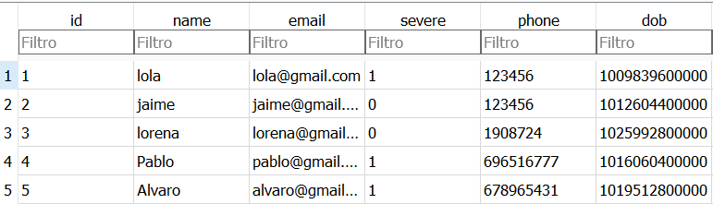
JDBC PATIENT MANAGER
Menu of Hospital Department
Patient's Table
Patient registered
Patient Inserted

Slide 12
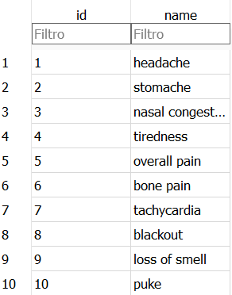


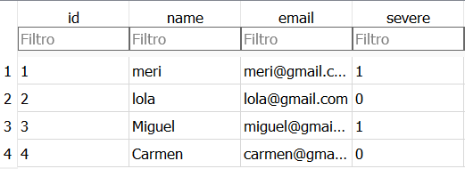
JDBC SYMPTOM MANAGER
Table that connects Patient and Symptoms
List of Symptoms
Symptom's Table
Patient Table

Slide 13
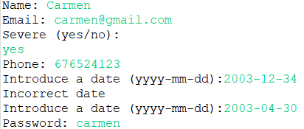
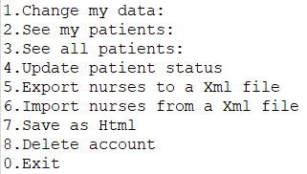

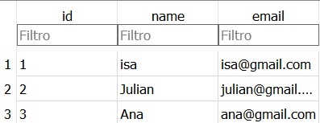

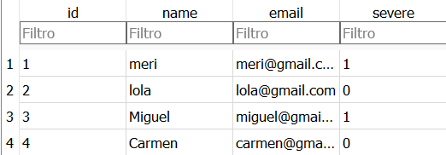
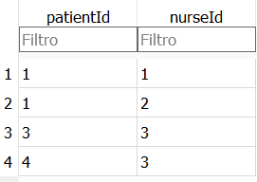
JDBC NURSE MANAGER
NURSES
PATIENTS
Nurse's Elements
Nurses and Patient Inserted
Changing the severity of a patient
Nurse's Menu

Slide 14
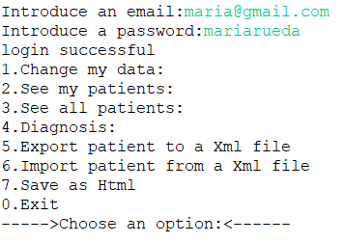
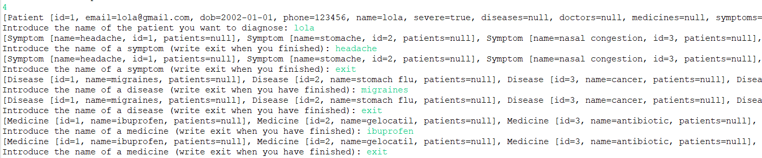
JDBC CLASSES

Slide 15
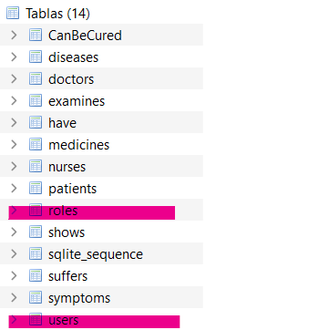
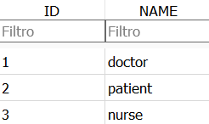
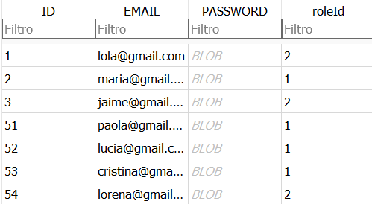
JPA

Slide 16
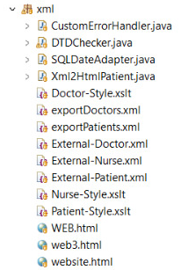
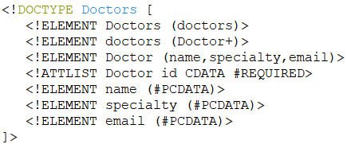
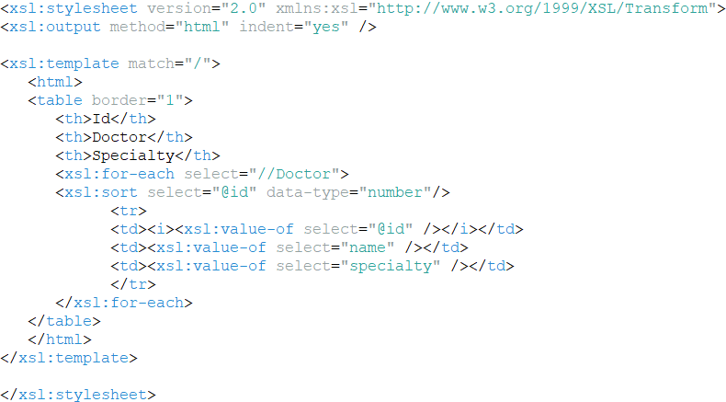
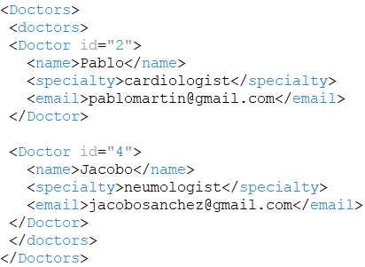
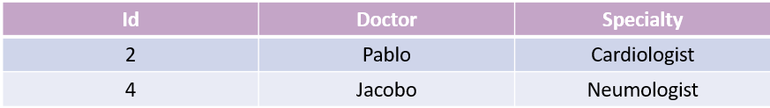
MARSHALL
JAVA2XML
XML2HTML
DTD
UNMARSHALL
XML2JAVA
XSLT
XML
XML

Slide 17


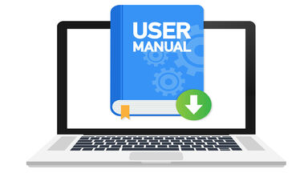


CONCLUSION
Patient care
Efficiency
Organization
Working properly
Fulfil all assumed objectives
Ready to be used

Slide 18


THANKS FOR YOUR ATTENTION
By:
Lola Sánchez,
María Rueda,
Jaime Soler,
Kacper Borysewicz

